Slide 1
What’s New In Azure A quick tour (with many demos!)
George Moore
Azure Engineering Team

Slide 2
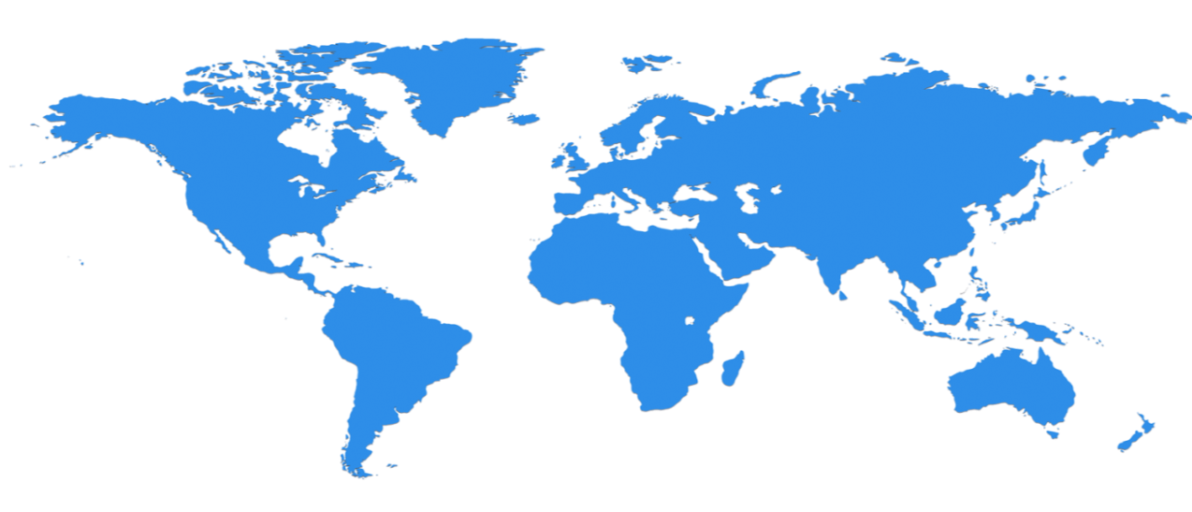

New Azure Regions
North Central US
Illinois
United Kingdom
2 Regions
West Europe
Netherlands
Central US
Iowa
Canada Central
Toronto
Canada East
Quebec City
Germany North East
Magdeburg
China North
Beijing
US DoD West
Iowa
US Gov
Iowa
Korea
Seoul
North Europe
Ireland
Germany Central
Frankfurt
China South
Shanghai
Japan East
Tokyo, Saitama
West US 2
East US
Virginia
West US
California
France
Paris
India Central
Pune
Japan West
Osaka
East US 2
Virginia
France
Marseille
US Gov
Virginia
India South
Chennai
Korea
Busan
West Central US
South Central US
Texas
India West
Mumbai
US DoD East
Virginia
East Asia
Hong Kong
US Gov Arizona
US Gov Texas
SE Asia
Singapore
Australia East
New South Wales
38
regions
announced
Brazil South
Sao Paulo State
Australia South East
Victoria
30 generally available, 8 in build-out
Regions noted in green indicate build-out

Slide 3
Availability: Guaranteed VM Uptime SLAs
New!
Single-Instance: 99.9%
Azure is the only public cloud provider to offer a guaranteed single-instance VM SLA
Multi-Instance: 99.95%
Two or more VMs in an Availability Set

Slide 4
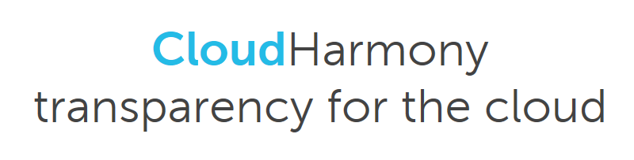
Demo CloudHarmony Uptime Reporting

Slide 5
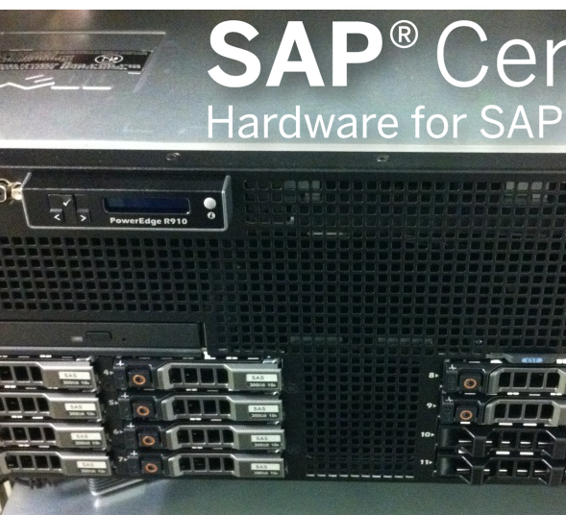
Largest scale-up servers in the cloud
New!
576 core single-node
12 TB single-node
32 TB multi-node
Bare metal performance

Slide 6
Microsoft OSS Fun Facts
The Vice President of the Apache Foundation works in the Azure Compute team
Microsoft has the most contributors on GitHub
Microsoft Joined Linux Foundation
The co-creator of Kubernetes is the development manager of Azure Resource Manager and Azure Container Service
Azure Container Service is completely open sourced

Slide 7

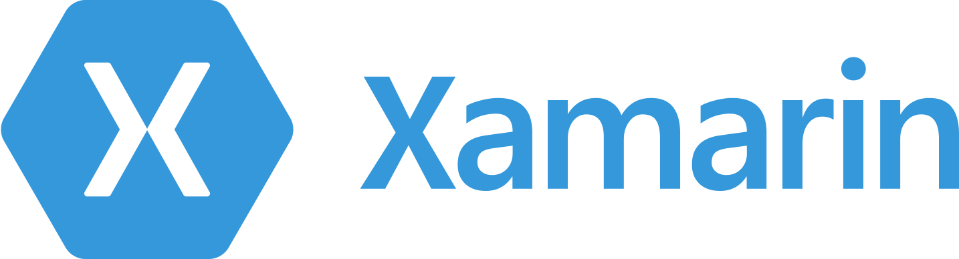



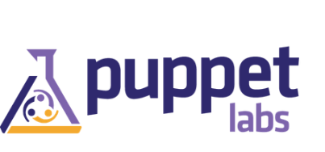

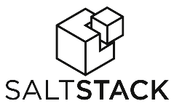












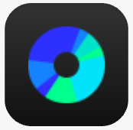




















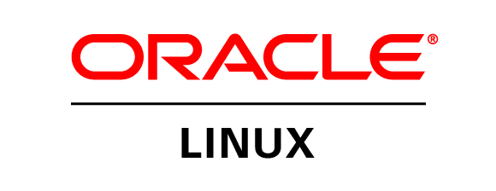
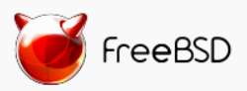

Any app, language, device or OS works with Azure
DevOps
Clients
Management
Applications
PaaS &
DevOps
App Frameworks
& Tools
Databases &
Middleware
Infrastructure

Slide 8

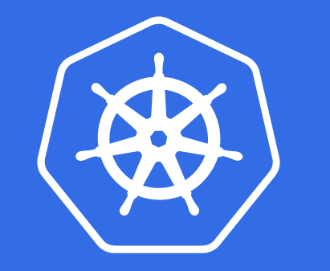
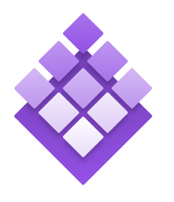
Azure Container Service
New Support for Kubernetes
Microsoft Acquires Deis:
Helm (Kubernetes Package Manager)
Workflow (Kubernetes CICD pipeline)
Steward (Kubernetes Service Broker)
Kubernetes
DC/OS
Swarm

Slide 9
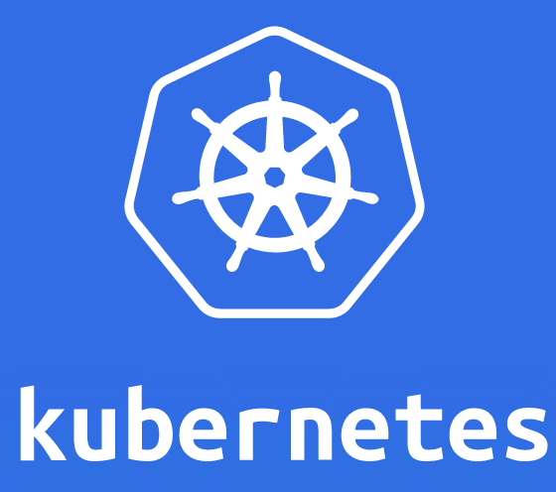
Demo kubernetes and helm

Slide 10

Azure
Autodesk

Slide 11



Autodesk + Azure
Integrated rendering on Azure CPUs and GPUs in all 38 Azure regions, with full compliance and security

Slide 12

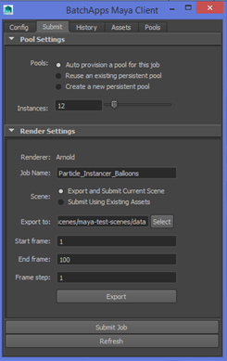

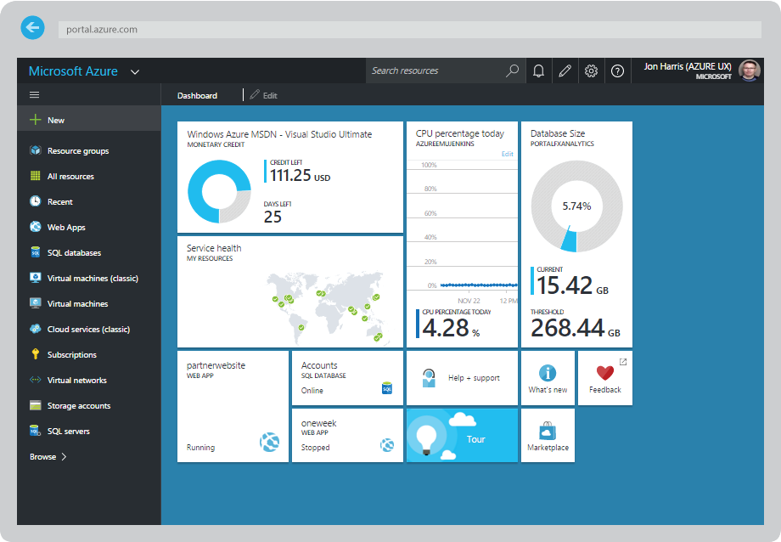
How does it work?
Azure Batch
Autodesk 3ds Max / Maya
Integrated Client Plugin
upload inputs
Manage digital assets
submit job
Split Job in frames
VM
VM
VM
REST API
Return Output
Renderer
Renderer
Renderer
Usage & Telemetry
Job Monitoring & Management
Usage Reporting
Metering & Single Bill
Azure Portal

Slide 13
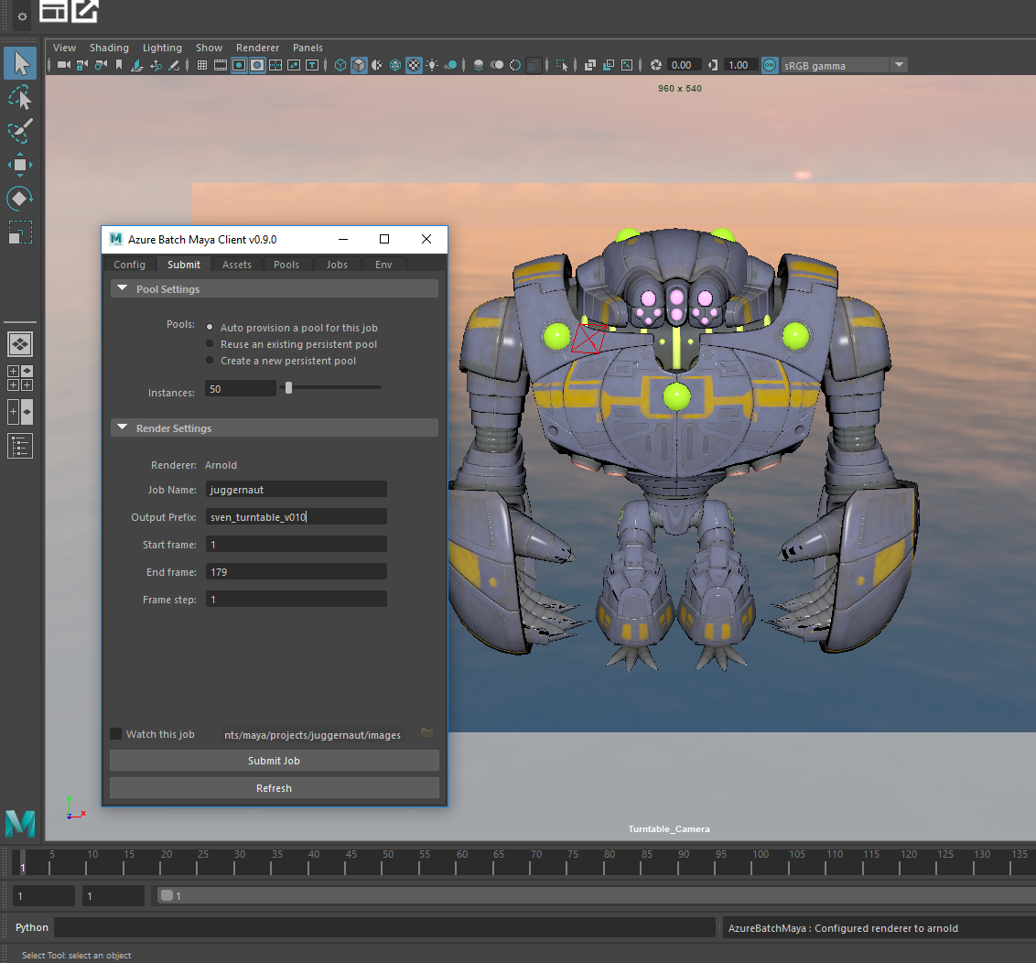

Demo Azure Batch Rendering Platform

Slide 14


Slide 15



Slide 16



Slide 17
rendering.azure.com

Slide 18
Low-Priority VMs

Slide 19
Low-Priority VMs Overview
Significantly lower priced compute:
Up to 80% discount compared to on-demand price
Fixed price
All Batch VM sizes and regions
Uses surplus capacity; availability could vary; VMs could be preempted
Suitable workloads:
Distributed parallel jobs - many discrete tasks, interrupt tolerant, shorter task execution times, flexible job completion time
E.g. Dev, test – regression, scale, load
Value:
Get work done for lower cost, faster, or do more for same price

Slide 20
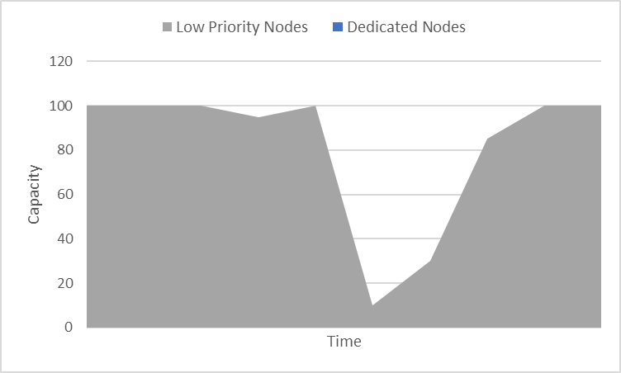
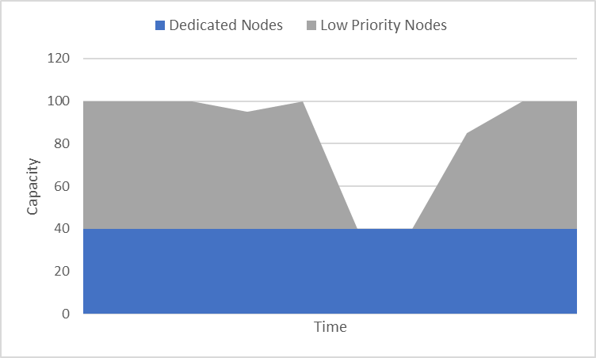
Options for using low-priority VMs
Goal: Lowest cost
Pool config: All low-priority, no dedicated
Job: Most potential variation; available capacity may vary
Goal: Lower cost, guaranteed baseline capacity
Pool config: Fixed low-priority and fixed dedicated
Job: Min throughput and max job time guaranteed

Slide 21
Azure Batch support for low-priority VMs
Batch Pools:
Contain low-priority and/or dedicated VMs
Scale low-priority & dedicated independently; use resize operation or auto-scale
Job does not need to know about pool VM types
// Create a Pool
CloudPool pool = PoolOperations.CreatePool (“Pool1”, “Standard_D14_v2”, vmConfig);
pool.targetDedicatedComputeNodes = 20;
pool.targetLowPriorityComputeNodes = 80;
pool.Commit();
// Get Pool info
CurrentDedicated = pool.CurrentDedicatedComputeNodes;
CurrentLowPriority = pool.CurrentLowPriorityComputeNodes;
// Resize Pool – no dedicated, all low-priority
pool.Resize(0, 100);

Slide 22
New Compute SKU Roadmap
VM Sizes | ETA to Live
3.5 TB of Memory | Q2 CY’17
Dv3 - Hyper-threaded | Q2 CY’17
Ev3 - Hyper-threaded | Q2 CY’17
Latest generation GPU | Q2 CY’17
Skylake-based VMs | Q3 CY’17

Slide 23
Xcloud (codename) — build games, not servers
Xcloud is a comprehensive Gaming as a Service (GaaS) Azure platform for any client
DevOps Services
Integrated development operations that enable developers to model 3D content, share code, test builds, and ship games across platforms.
Graphic Services
Model, render, and check-in 3D content completely in the cloud using familiar Autodesk tools.
Simplified Pricing
MAU-based pricing reduces the complexity of using multiple Azure services and enables you to focus on acquiring users and transparently monetize games.
Multiplayer Services
Dynamic multiplayer server orchestration that enables developers to elastically respond to exponential player demand. Peer-to-peer multiplayer relay, chat, and VOIP.
LiveOps Services
Real-time telemetry and analytics, in‑game e‑commerce, livestreaming, advertising, and storage that enables developers to engage, retain, and monetize their players
User Services
Leverage out-of-the-box managed game services from Xbox Live, such as identity, chat, and matchmaking

Slide 24

Demo Cloud-Based Physics Offload

Slide 25
Thank You!

